Slide 1
Laura Wainman
Part III Student in the Department of Earth Sciences
Working with Lauren Marshall and Anja Schmidt in the Centre for Atmospheric Chemistry on my Part III project.
Academic interests: Volcanic eruptions, Volcano-Climate Interactions, Hazard Mitigation and Adaptation, Historical and Social Context of Eruptions.

Slide 2
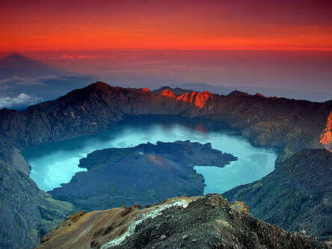
The Climatic Impact of the 1257 Samalas Eruption
Samalas Eruption was one of the largest eruptions in the past 7,000 yrs. On the island of Lombok, Indonesia.
VEI of 7, injected an estimated 119Tg of SO2 into the Stratosphere.
Significant radiative effects with estimated surface cooling of between -0.7 and -4C* based on model and proxy data.
*Models didn’t account to aerosol microphysics so overestimate cooling.

Slide 3
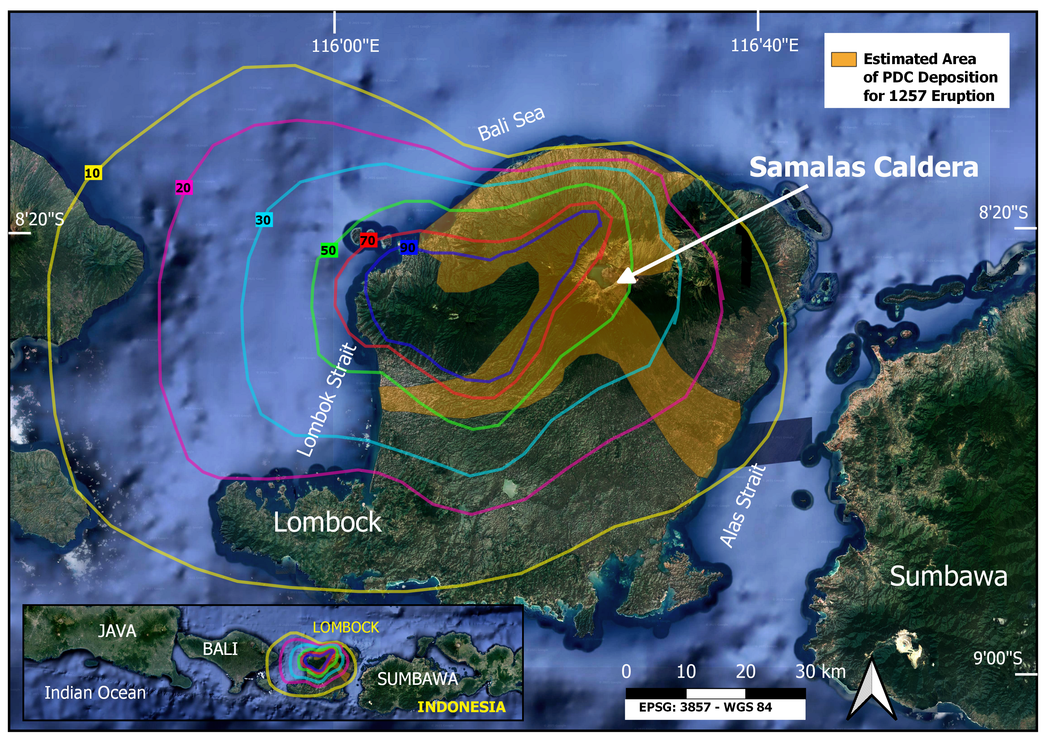

Slide 4
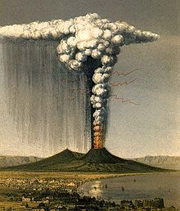
The Impact of the Eruption
Wide-scale but heterogeneous impacts on global climate:
SAOD
SAT
Global Precipitation
Ozone (uncertainty over magnitude of Halogen injection into stratosphere)
Impacts of the eruption are recorded in numerous historical sources. Babad Lombok is one of the first direct accounts of an eruption. Also recorded in sources from Japan, Central Asia, Germany, France.
“Samalas and the Fall of the Mongol Empire: A volcanic eruption's influence on the dissolution of history's largest contiguous empire” – Zoltan, 2021

Slide 5
Questions I hope to investigate
[1] To investigate the climatic response of the 1257 Samalas Eruption using a combination of model simulations and proxy data.
[2] To investigate how prior atmospheric conditions, such as ENSO and QBO state, as well as the timing of the eruption affect the climatic impact.
[3] To determine if an ENSO response is present following the eruption and if so, to understand the mechanisms behind this response and whether the response is sensitive to pre-eruption initial conditions.

